Slide 1
Cookbook for Practice 3.3
实践3.3攻略
Cong Li 李聪

Slide 2


Initialization 初始化 (1)
Duplicate ‘vector.cpp’ as ‘pipeline.cpp’
将’vector.cpp’复制为’pipeline.cpp’
Add another definition ‘ORIGINAL’ to represent the 16 different coefficients for ‘mu’
加入另一个 ‘ORIGINAL’作为预定义，代表16个不同的’mu’系数
Make the ‘SERIES’ definition changeable from compilation option to see how the execution time varies w.r.t. the number
将‘SERIES’的定义改为可以由编译选项输入，
以便观察执行时间如何随这个数值变化

Slide 3

Initialization 初始化 (2)
Now change the coefficient array initialization from
现在将系数数组初始化从
to
改为
Write another declaration for the ‘mu’ array
另外对’mu’数组进行声明

Slide 4
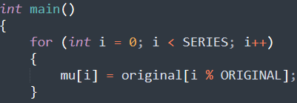
Replicating Coefficients
复制系数
At the start of the program, replicating the coefficients from ‘original’ to ‘mu’ based on the ‘SERIES’ value
在程序开始处，根据’SERIES’的数值
将系数从’original’复制到’mu’

Slide 5

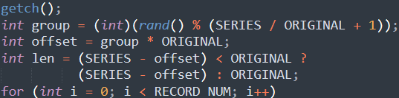
Selective Output
选择性输出 (1)
At the start of the file, include ‘stdlib.h’ header
在最开始处，引用’stdlib.h’头文件
Before the result output, randomly select a replica, calculate
the starting index offset, & limit the output series number
在结果输出前，随机选择输出的副本，
计算副本初始的下标，并限制输出的序列的数量

Slide 6


Selective Output
选择性输出 (1)
Change the output from
将输出打印从
to
改为
Vary ‘SERIES’, compile & run it 改变’SERIES’的值，编译并运行之
mingw32-make SRC=pipeline.cpp NATIVE=1 EXTRA_CXXFLAGS="-DSERIES=4" -B
run-pipeline.exe

Slide 7
The End

